Slide 1
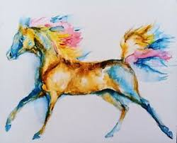
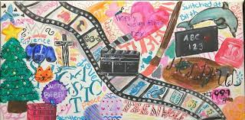
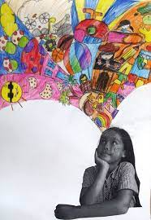
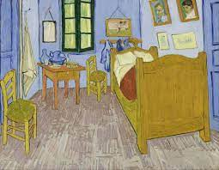
Year Groups: 8
Subject: PSHE
Link to learning:
We have been learning about Goals and Dreams in PSHE and this term we are going to be looking at a Healthier me topic. For your Enrichment homework I would like you to tell think about all the things that make you the amazing person you are and create a piece of art to represent you!
Task:
I want to learn more about you and I would like you to reflect on what makes you amazing. Your task is to create a piece of art to fit the title “This is me!” I would like you to create any type of art that tells me more about you! This is all about expressing yourself and I want you to be as creative as you can. You could paint a picture of your room, draw a favorite pet, do a collage of all the things you love, create a family tree or even create a fantastically colorful poster about your favorite sports team/hobby. Be creative! Show me what makes you happy in a piece of art.
Expectations:
Create a piece of art that tells me about you and what you love.
Be creative – you can create anything you like!
If your stuck for ideas than please ask for help
Have fun! Because this is all about you, it should be fun and exciting. If you have fun, I will see it in your work!
Due date:
Monday 27th March 2023
Due date:
Monday 4th of April 2022

