Slide 1
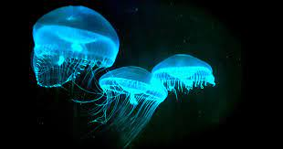
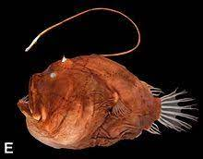
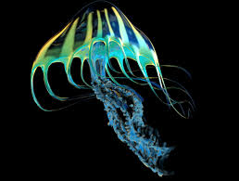
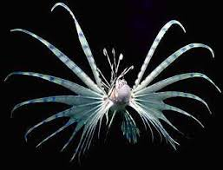
Year Groups: 5
Subject: Art
Link to learning:
This term we are going to be learning about ‘Under the Sea’. We have started looking at the strange creatures in the deepest part of the ocean. They have Bioluminescence so they shine where there is no sun.
Task:
I would like you to create your own creature of the deep. You can create it in any medium you like, Sculpture, painting, Drawing, Collage etc… Think about how the creature is constructed and why? Where does it have its bioluminescence and why? Where can you find this creature and how can you use the materials you have to make it look like it is glowing in the deep dark of the ocean?
Expectations:
Create some sketches of your ideas to refine them
Sketch out your chosen design
Add in all the detail you want
Make your creature look like it is lurking in the depth of the ocean! Use your colors wisely!
Tell me about your creature, what is it? Where does it live? How does it catch its prey or is your creature the prey?
Be super creative, I would love to hang your work up on the Art Avengers wall!
Due date:
Monday 4th of April 2022
Due date:
Monday 22nd May

