Slide 1
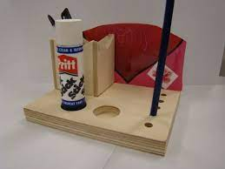
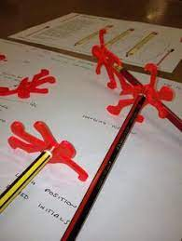
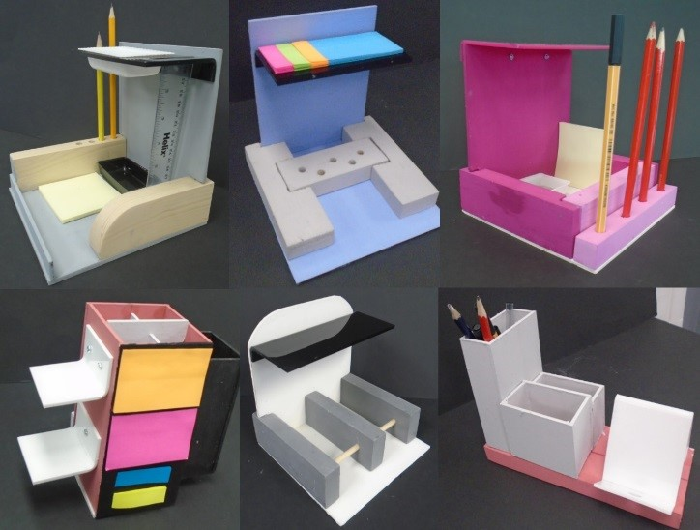
Due date:
Monday 13th February 2023
Year Groups: 7
Subject: ADT
Link to learning:
We are going to be expanding on our Graffiti art project, moving into the DT room and creating phone holders based on the work of Keith Haring. You are going to be learning about product development, design and functionality.
Task: Design your own desk tidier
This is all about product development. I would like you to develop your own desk tidier. You can make it if you chose as well. Think about what needs to be included and how you would make it a successful design.
Expectations:
Research and print some pictures of examples that you can use for inspiration.
Write down what you need to include in your design.
Draw some design ideas of your own. There should be at least 3 options. Work out what will work, what you need to include and what will be successful.
Draw or make your final design.
Make sure you annotate and explain your ideas.

