Slide 1
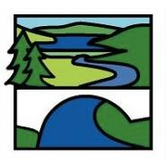
Enrichment Homework
Summer 1
Year Group: 7
Subject: Geography
Link to learning:
This term we will be looking at how erosion, deposition and transportation create and change coastal landforms all the time. We will also be looking at how coastal management strategies are becoming more important over time.
Task: The year is 2100 and climate change is causing sea levels to rise. Parts of the North East coast are at risk of erosion from the North Sea in Bamburgh and Seahouses. You have been asked to come up with innovative ideas on how erosion can be prevented on this coastline.
Expectations:
Produce a 3D map of the coast, where you will label how you can protect the coastline from erosion and what you will use.
Use your imagination regarding materials which could be used and replicate this on your map.
Include a key.
A short written explanation of which features you have incorporated onto the map and what the purpose of each of them are. (at least ½ a side of A4).
Due date:
Monday 23rd May

