Slide 1
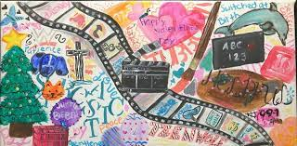
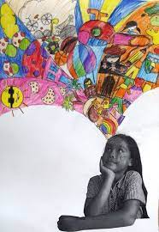
Year Groups: 5
Subject: Art
Link to learning:
You are now half way through your first year at Bellingham Middle School. I am really enjoying getting to know you and would love to learn more about you. For this enrichment homework, I would like you to create a piece of art all about you! What you like and what makes you happy?
Task:
The title of your work is “This is me!” I would like you to create any type of art that tells me more about you! This is all about expressing yourself and I want you to be as creative as you can. You could paint a picture of your room, draw a favorite pet, do a collage of all the things you love, create a family tree or even create a fantastically colorful poster about your favorite sports team/hobby. Be creative! Show me what makes you happy in a piece of art. I would love to display your work in the hall.
Expectations:
Create a piece of art that tells me about you and what you love.
Be creative – you can create anything you like!
If your stuck for ideas than please ask for help
Have fun! Because this is all about you, it should be fun and exciting. If you have fun, I will see it in your work!
Due date:
Monday 27th March 2023
Due date:
Monday 4th of April 2022

