Slide 1
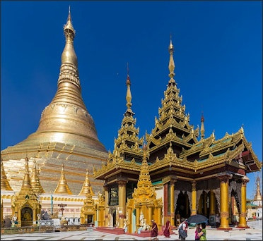
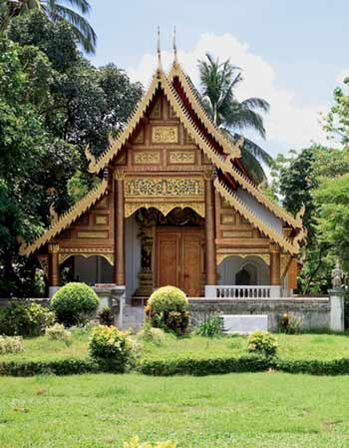
Enrichment Homework
Summer 1
Year Group: 5
Subject: RE
Link to learning:
This term you are studying Buddhism. Buddhist temples around the world have different structures and shapes for different reasons.
Your task:
Research the different structures of Buddhist temples around the world and find out what the different structures represent. You will need to present your findings, along with pictures in your book with clear explanations.
Expectations:
Pictures and detailed information about 3 different Buddhist temple structures from around the world.
Clear, detailed information about the purpose of each different structure.
A glossary for words relating specifically to the temples.
Accurate full-stops, capital letters, commas and spelling.
Due date:
Monday 22nd May 2023

