Slide 1
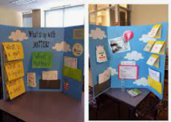
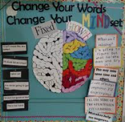
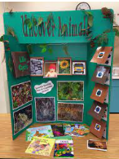
Enrichment Homework
Spring 2
Year Group: 5
Subject: History
Link to learning:This half term the children are continuing to learn about Anglo-Saxon Britain.
Task: Research what the life of an Anglo-Saxon in Britain was like. Create an interactive poster showing ‘Anglo-Saxon life’. Topics you may want to include: Food, leisure, clothes, job, culture, music and religion. I’ve attached some examples of interactive posters:
Expectations:
You need to consider:
The use of colour
Including facts
The interactive element (flaps, doors, windows, 3-D)
Making it look appealing
How you will present your information
Images
Headings and subheadings
Due date:
Monday 27th March 2023

