Slide 1
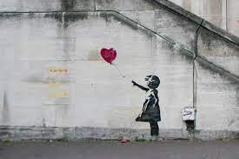
Due date:
Monday 13th February 2023
Year Groups: 8
Subject: ADT
Link to learning:
You are learning about street art, Banksy and Mural arts. You are creating your own 3 plate stencil and designing your own mural art for the school.
Task: To create your own Banksy inspired stencil design
I would like you to research and design your own stencil. It can be a picture, symbol or graffiti text. You have to create at least 2 plates (colours). You can use the spray paint in the art room (with supervision) to produce your design once you have created your stencils at home.
Expectations:
Research the work of Banksy and Space invades. Look at the work they do for inspiration for your own design.
Sketch some ideas for your own design. It could be a picture, symbol or graffiti writing.
Draw your idea and split it into the plates you will need to create. Remember one plate per colour.
Create your stencils, you can use the spray paint in the art room to do your final picture if you chose.

