Slide 1
Enrichment homework

Slide 2
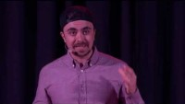
What's the point of Enrichment Homework?
https://www.youtube.com/watch?v=GtOqpvAoQMA

Slide 4
Mrs. McGregor top trumps
Math
Art
Geog
French
Science
PE
Writing
Reading
Music

Slide 5
I didn’t read a full chapter book until I was 20 Reading was Uncomfortable I didn’t have any talent for it and it would take a long time.

Slide 6
What's the point?
Every single day that I have been here in Bellingham someone in lesson has said to me either;-
Well it’s easy for you
You can do it
I can’t do it
Its to hard
I don’t like it!
Its rubbish
What do I always answer?

Slide 7
If you don’t like it,
it just means you’re not finished yet!
Learning something new takes time and effort!

Slide 8
Learning can be uncomfortable
It can be challenging if you don’t have natural talent for it
It can take a long time to do.
I wasn’t particularly good at art. I was better at other subject. I enjoyed art, so I did more of it and became better at it.
What about my writing?

Slide 9
I did everything I could to avoid it. I HATED it. It made me uncomfortable. I had no talent for it and it would always take a long time.
As I have got older, I had to do more and more of it. I couldn’t always avoid it. The more I had to do it, the better I got at it. It can still make me very uncomfortable, but I don’t feel like I don’t have any talent for it and I am getting better and better at doing it quicker. It will always be something that is more challenging for me, but I don’t avoid it. Practice, practice, practice.

Slide 10
Enrichment homework is about trying new things. Its about having an open mind and its about challenging yourself. When you have completed it, you might find that you have discovered something you really like. You might have learnt a new skill or even achieved something you never thought possible.
We are all programmed to think this is what I am good at, this is what I'm not good at.
This is wrong! Just give things a go. It might be Uncomfortable, you might have no particular talent for it and it might take time. However, you are guaranteed to grow as a person, because you tried. Its not trying which is the problem. Not the result of trying!

Slide 11
Mrs. McGregor top trumps
Math
Art
Geog
French
Science
PE
Writing
Reading
Music

Slide 12
What's the point of Enrichment Homework?
To try to learn something you haven’t done before
To improve your skills
To surprise yourself!
To push your ability
To learn something new about yourself

Slide 14
So how does it work now?
Each half term you will be given two choices. It might be a subject to study, a skill to learn or a passion a teacher wants to share with you.
Your activity will be split into different sections and you will be reminded of these sections each week by the teacher who has set the work.
By the end of the half term. You will be expected to hand in a well thought out, substantial piece of work, demonstrating what you have learnt and the processes you used.
You have time at lunch in the library or in the art room to work on your enrichment, you can always ask your teacher for help and there is no excuse to not get it done.

Slide 16
A skills Progression example

Slide 17
Horse Jumping
Stride patterns

Slide 18
What are showjumping distances?
Combinations and distances are an elementary part of the showjumping sport.
In order to ride combinations and distances confidently, it is important for the rider to know how to measure the distances between two jumps as well as how many strides are needed.
If the rider knows about these two factors, he or she can decide how to optimally ride the combination or the line.
They are sequences of two to three jumps separated by one or two strides. A lot of possibilities exist when building combinations and the preparation for each of them is very important.

Slide 19
Showjumping combinations can be of two types. A double is a sequence of two elements whereas a triple is made up of three jumps. The type of jumps, and in what order they are encountered, determine the level of difficulty. Two jumps are always separated by one or two strides which makes it necessary for horse and rider to be focused and to react quickly. If this was in a competition then this sequence would count as one jump.
s

Slide 20
Here is an example of 3 stride pattern

Slide 21
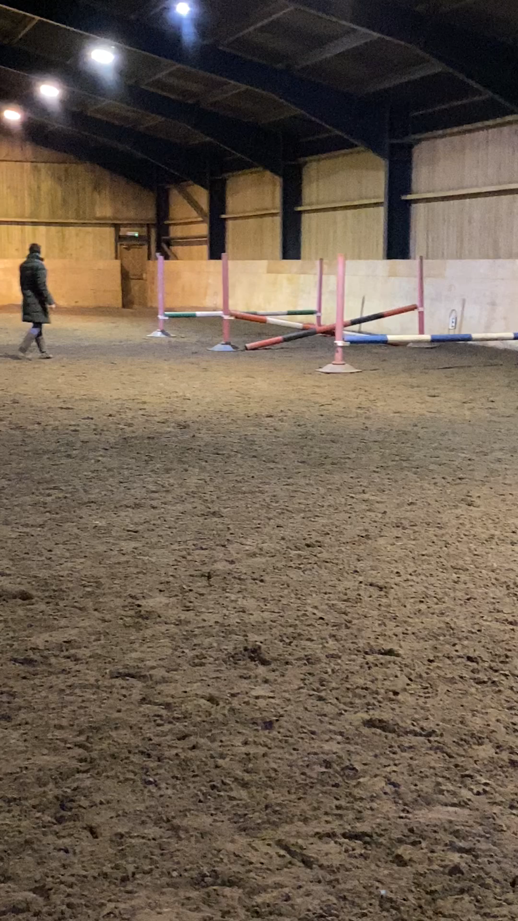
After working with the horse, here is an example of reducing the stride pattern to 2 strides.

