Slide 1
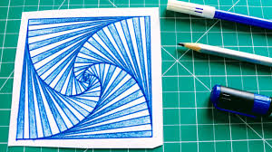
Enrichment Homework
Summer 1
Year Group: 7
Subject: ADT
Link to learning:
We have been learning all about patterns and how artists use patterns in their work in all manner of ways.
Task:
I would like you to research an artis who uses patterns in their work and create your own work of art based on their work. The artwork can be anything from woodwork, graphic design, painting, drawing, video etc…
Expectations:
Research some artists that use patterns in their work and find one that you like
Draw out an idea of what you are going to create. Think about how you will incorporate their pattern idea in your own work
Create your work of art. Think about the size and materials that you will need.
Be creative, have fun and enjoy!
Due date:
Monday 18th October 2021
Date due:
Monday 232nd May 2023

